Slide 1



2025 Educational Materials
Katie Williams
Lead Teacher
essrteacher@gmail.com

Slide 2

This Unit is designed to teach students about the Pedigree Stage Stop Race through Reading and Writing Activities . Students will engage in various activities such as biography reading and writing, following and charting a musher on the trail, mapping the trail, comparing and contrasting the weather with their hometown, poetry writing, and informative and opinion text writing. Each activity has instructions.
Table of Contents
Common Core Standards
Pedigree Stage Stop Race Word Wall
Picture/Facts Cards: Reading Activity
Picture/Word/Fact Cards Matching Activities
Racer’ Bios
Character Traits Information Chart
Character Traits Writing Activity
Adjective Word Web
Musher’s Daily Log Information Chart
Map the Wyoming Trail: Wyoming Map Activity
Map the Whole Race Trail: Rocky Mountain States Map Activity
Compare Weather Chart
Compare and Contrast Two Mushers Venn Diagram
Wrap it Up Activity
“Wyoming” Cinquain
“Pedigree Stage Stop Race” Cinquain Writing Activity
Class Poetry Writing Book Cover
Informative Text Writing Information Chart and Graphic Organizers
Opinion Piece Writing Information Chart and Graphic Organizers
Writing Prompts and Paper

Slide 3
“© Copyright 2010. National Governors Association Center for Best Practices and Council of Chief State School Officers. All rights reserved.”
ELA Common Core State Standards:
2nd Grade
Fact Cards, Reading Texts
RL2.1: Ask and answer such questions as who, what, where, when, why and how to demonstrate understanding of key details in a text.
RF2.3: (a-f) Know and apply grade-level phonics and word analysis skills in decoding words.
RF2.4: Read with sufficient accuracy and fluency to support comprehension.
Cinquain Poetry Writing, Writing, and Writing Prompts:
W2.1: Write opinion pieces in which they introduce the topic or book they are writing about, state an opinion, supply reasons that support the opinion using linking words(e.g. because, and, also) to connect opinion and reasons, and provide a concluding statement.
W2.2: Write informative/explanatory texts in which they introduce a topic, use facts and definitions to develop points and provide a concluding statement or section.
W2.5: With guidance and support from adults and peers, focus on a topic and strengthen writing as needed by revising and editing.
L.2.1:a-f: Demonstrate command of the conventions of standard English grammar and usage when writing and speaking.
L2.2:a-e: Demonstrate command of conventions of standard English capitalization, punctuation, and spelling when writing.
Picture/Fact Cards Match
RI2.4:Determine the meaning of words and phrases in a text relevant to grade 2 topic or subject area.
RF2.4a: Read on-level text with purpose and understanding.
2nd Grade Common Core Math Standards:
Graphing Alaska Temperatures and Hometown Temperatures:
2MD.10: Draw a picture graph and a bar graph
(with single unit scale) to represent a data set with up to 4 categories. Solve simple put-together, take apart, and compare problems using information presented in a bar graph.

Slide 4
ELA Common Core State Standards:
3nd Grade
Fact Cards, Reading Texts,
RL3.1: Ask and answer questions to demonstrate understanding of a text, referring explicitly to the text as the basis for the answers.
RL3.2:Determine the main idea of the text; recount the key details and explain how they support the main idea.
RF3.4: Read with sufficient accuracy and fluency to support comprehension
Cinquain Poetry Writing, Writing, and Writing Prompts
W3.1: Write opinion pieces on topics or texts, supporting a point of view.
a. Introduce the topic or text they are writing about, state an opinion,
and create an organization structure that lists reasons.
b. provide reasons to support the opinion.
c. Use linking words and phrases (e.g. because, therefore, since, for
example) to connect opinion and reasons.
d. Provide a concluding statement or section.
W3.2:Write informative/ explanatory texts to examine a topic and
conveys ideas and information clearly.
a. Introduce a topic and group related information together include
illustrations when useful to aiding comprehension.
b. Develop the topic with facts, definitions, and details.
W3.5: With guidance and support from adults and peers, focus on a topic
and strengthen writing as needed by revising and editing.
W3.7: Conduct short research projects that build knowledge about a topic.
L3.1:a-i: Demonstrate command of the conventions of standard English grammar when writing and speaking.
L.3.2:a-g: Demonstrate command of the conventions of standard English capitalization, punctuation, and spelling when writing.
L.3.3: Use knowledge of language and its conventions when writing,
speaking, reading, or listening.
a. Choose words and phrases for effect.

Slide 5
Common Core Standards Math – Grade 3
Represent and interpret data.
3.MD.B 3 Draw a scaled picture graph and a scaled bar graph to represent a data set with several categories. Solve one- and two-step “how many more” and “how many less” problems using information presented in scaled bar graphs.

Slide 6
Word Wall Words
Introduce the new words at the beginning of the lesson. These are words that students will need to know during the unit.
Picture/Fact Cards for Reading:
The picture/fact cards give information about the picture. Students can practice reading them before they read the text about the Iditarod. They can be put in a center or make sets for independent reading. Students will need to read these before matching the picture/fact cards.
Materials:
Make copies of the Word Wall Words
Laminate and display in your classroom.
Make copies of the Picture/Fact Reading Cards
Laminate, cut, and place sets in labeled plastic bags or envelopes.
Picture/Word or Picture/Fact Cards Match
These can be used at the beginning of the unit to help students learn the new vocabulary as a matching activity. They are best to use after students have read the Picture/Fact Cards: (pages ). The Picture/Word cards will help your ESL students and struggling readers. For other students you can have them match the Picture/Fact Cards.
Materials:
Make copies of the Picture/Word Cards
Make copies of the Picture/Fact Cards
Make a copy of the Center Activity Task Card
Laminate the sets you are using, cut, and place in plastic labeled
bags or envelopes.

Slide 7
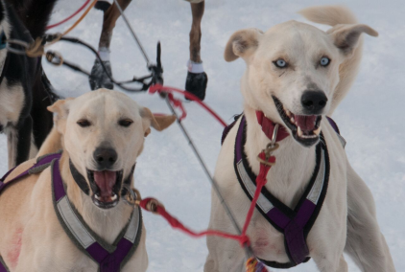
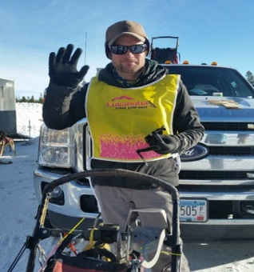
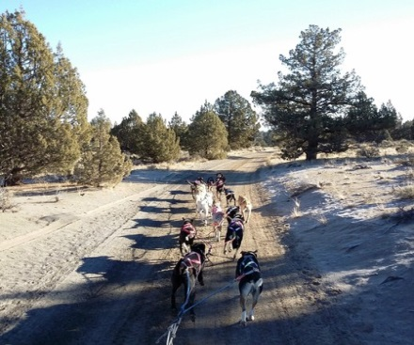
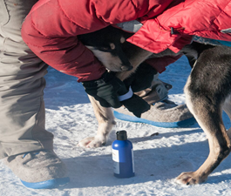
pl
Alaskan husky
yellow bib
trail
booties

Slide 8
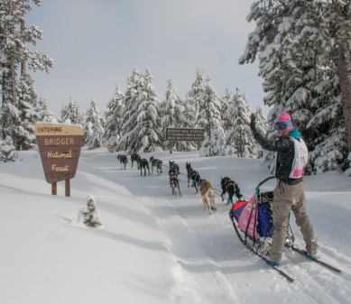
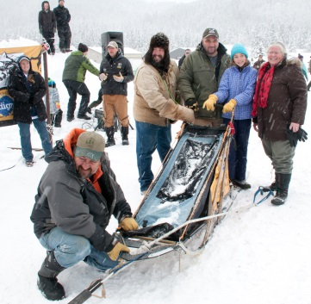
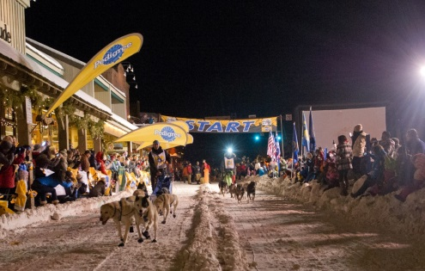
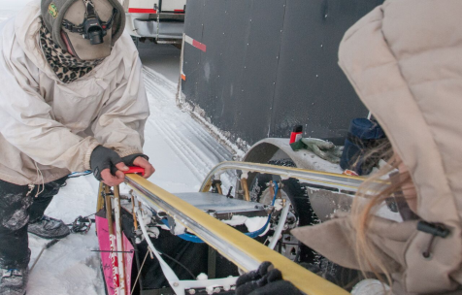
pl
musher
dog sled
chute
runners

Slide 9
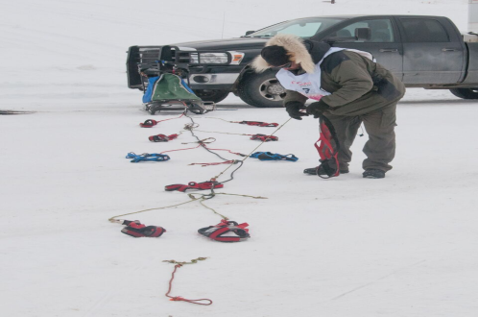
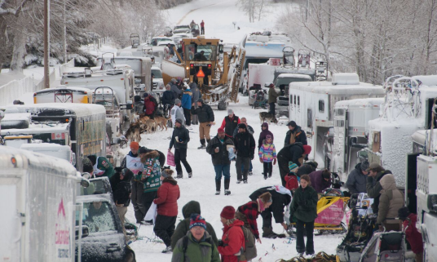
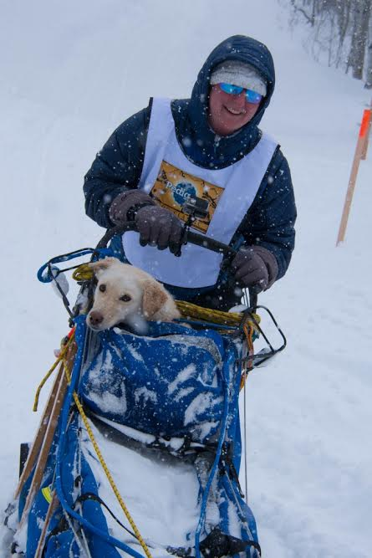
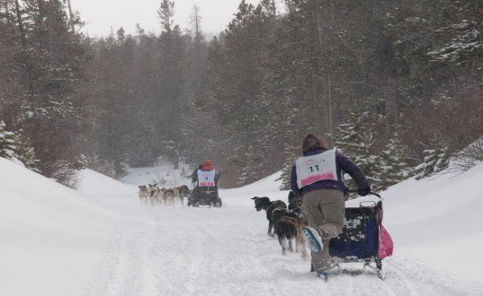
pl
gangline
and
harness
staging area
dog in a
basket
pedaling

Slide 10
pl
An Alaskan Husky is a large dog with thick fur used to pull dog sleds.
The yellow bib is given to the musher with the fastest time of the day.
The trail is the path that the racers must follow to the finish line of each stage.
Booties are rubber, plastic, or fabric covering for dogs’ paws, used to protect the animal from cold weather, small cuts, or sores.

Slide 11
pl
A musher is the driver of the dog sled in a dog sled race. Mushing is a sport or method of transportation powered by dogs.
A dog sled is a sled pulled by one or more sled dogs used to travel over ice or snow.
The chute is the beginning of the race course at the starting line.
The runners are the two bottom pieces of the sled that come in contact with the snow.

Slide 12
pl
The gangline and harness are the collection of lines to which dogs are attached.
The staging area is where the mushers and dog ready themselves for the upcoming race.
Dog in basket is when a dog an injured or tired do is carried safely on the sled.
Pedaling is pushing the sled with one foot while the other foot remains on the runner.

Slide 13
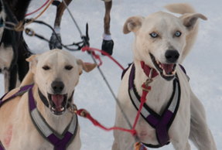
Alaskan husky
yellow bib
trail

Slide 14
booties
musher
dog sled

Slide 15
chute
runners
gangline and harness

Slide 16
staging area
dog in a basket
pedaling

Slide 17
This is a large dog with thick fur used to pull dog sleds.
Alaskan husky
This is given to the musher with the fastest time of the day.
yellow bib
This is the path that the racers must follow to the finish line of each stage.
trail

Slide 18
These are rubber, plastic, or fabric covering for dogs’ paws, used to protect the animal from cold weather, small cuts, or sores.
booties
This person is the driver of the dog sled in a dog sled race. Mushing is a sport or method of transportation powered by dogs.
musher
This is a sled pulled by one or more sled dogs used to travel over ice or snow.
dog sled

Slide 19
This is the beginning of the race course at the starting line.
chute
These are the two bottom pieces of the sled that come in contact with the snow.
runners
These are the collection of lines to which dogs are attached.
gangline and harness

Slide 20
This is where the mushers and dog ready themselves for the upcoming race.
staging area
When a dog an injured or tired this is used to carry it safely on the sled.
dog in a basket
This is pushing the sled with one foot while the other foot remains on the runner.
pedaling

Slide 21

Picture/Word/Fact
Card Match
1. Put all the cards face
up on the table.
2. Match each picture
with the correct word
or fact.

Slide 22

Racers’ Bios:
There are 18 Racers’ Bios included in this packet. Each bio was submitted by the racer. There are several different activity you can do:
You can give out individual bios to individual or pairs of students. Each individual or pair can report on their racer before the race. They can make a poster about their racer including a map if where they are from or other pertinent info.
Then you can make a class book of all the bios so students can read during literacy or reading time.
You can make a shared reading book and read different bios on days leading up to the race.
Materials:
Make copies of the bios
Laminate and cut
Activities for the Bios:
Introduce the Character Traits Information Chart. Brainstorm traits the students think fit a sled dog race or musher. Students can fill in the graphic organizer. Then they can find proof to support that character trait.
Adjective Web:
Students will write 5 adjectives that describe a sled dog racer.
Materials:
Make a copy of the Character Traits Information Chart
Make copies of the Character Traits Graphic Organizer
Make a copy of the Adjectives Information Chart
Make copies of the Adjective Word Web
Picture/Word/Fact
Card Match
1. Put all the cards face
up on the table.
2. Match each picture
with the correct word
or fact.

Slide 23
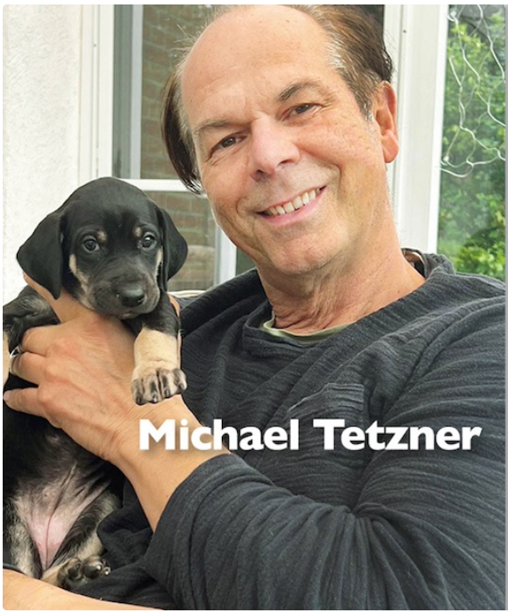
#1 -Michael Tetzner from Burg, Germany. Age 58.
Michael’s homebase is a farm in Burg, Schleswig-Holstein in northern Germany where he has a 60-dog kennel. He began mushing in 1987 after watching a sled dog race in Germany, then started running Siberian Huskies and he’s been racing dogs all over the world since. Michael placed third overall in the 2023 Fur Rondy Open World Championships and got an award for the best dog care. His daughter Leonie will be competing in her first Stage Stop this year.

Slide 24
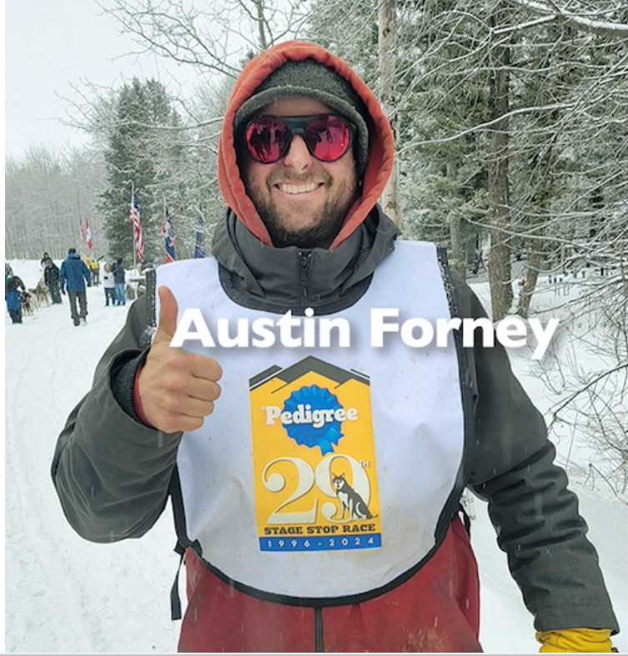
#2-Austin Forney from Leadville, Colorado. Age 43. A 9-time Pedigree Stage Stop Race finisher, Austin comes from a sixth-generation line of cattle ranchers in the Sandhills of western Nebraska. He lives and trains in Leadville, Colorado elevation 10,152 ft. Austin says he and his handlers are “excited to spend another year in Wyoming with all of the amazing people and dogs of the Pedigree Stage Stop Race” and thanks his family and friends for their continued love and support. “See you in Jackson!!!”

Slide 25
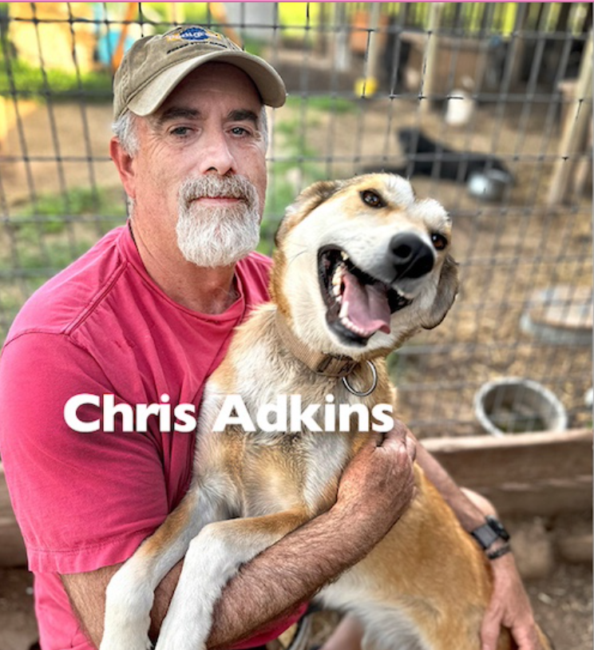
#3-Chris Adkins from Canyon Creek, Montana. Age 56. Chris grew up running dogs and ran his first distance race, the Race To The Sky 500, at the age of 21. He entered the Stage Stop in 2010 as a training run for the Iditarod and fell in love with the trails of Wyoming. Chris and his wife Shannon, with the help of the kids, operate Mo Betta Sled Dog Racing, a 50-plus dog kennel in Sand Coulee, Montana. This will be Chris’ eleventh Stage Stop. “Apparently, I just can’t get enough of it!”

Slide 26
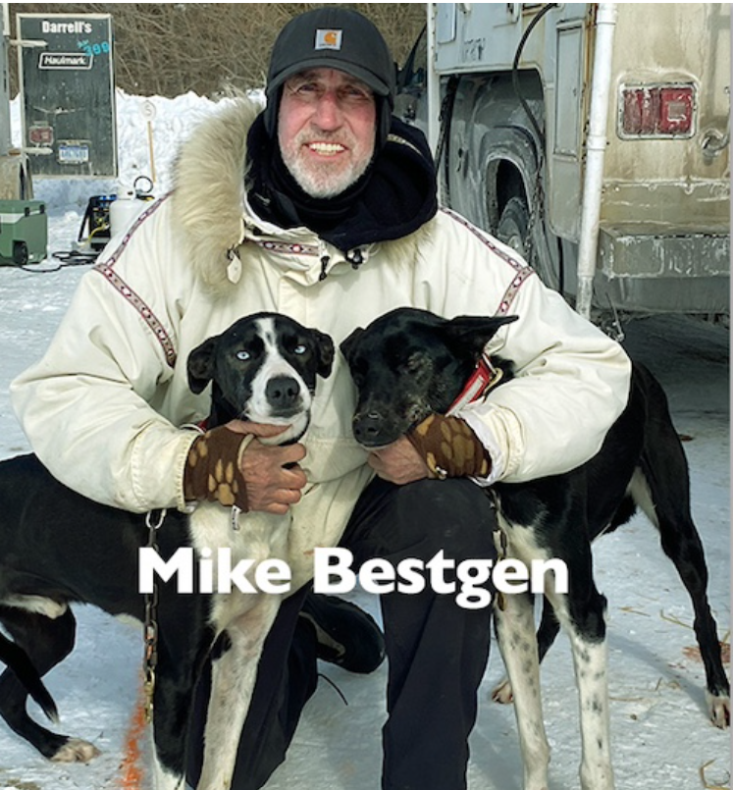
#4-Mike Bestgen from St. Cloud, Minnesota. Age 66. Mike has been running dogs since 1999, mostly in the Midwest, and in marathon and mid distance races. He’s a three-time winner of the WolfTrack Classic Sled Dog Race in Ely, Minnesota, two-time Midnight Run champ, and runner up at the Klondike Sled Dog Derby. ” A lot of my training is done on farmland, so very flat. I came out to do the Pedigree Stage Stop two years ago and fell in love with the people, trails and the race.”

Slide 27
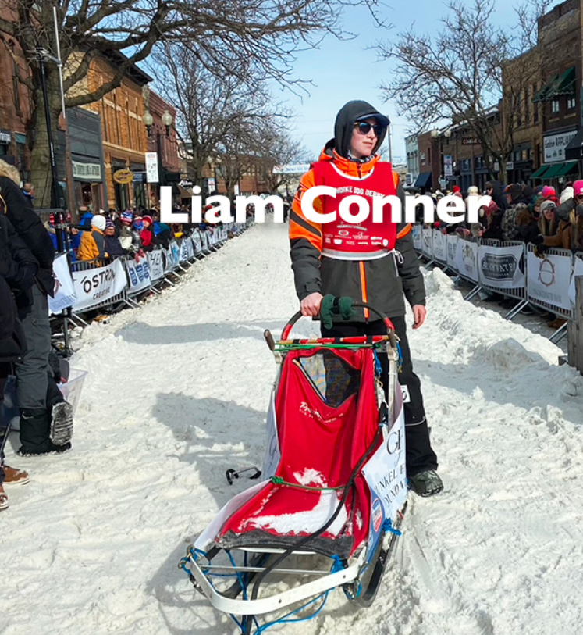
#5-Liam Conner from Loon Lake, Saskatchewan, Canada. Age 15.
Liam has been racing sled dogs since he was three years old. Like his Dad, he grew up racing the Ma Mow We Tak sprint circuit in Northern Canada. Two years ago, Liam ran the Klondike Dog Derby, finishing a respectable eighth out of 40 teams. His favorite sport is baseball, but he’s active in cross country running, track, basketball, and volleyball. Liam is excited to represent his family kennel and race against top competitors. “I can’t wait for the adventure to start!” says an enthusiastic first time Stage Stop musher.

Slide 28
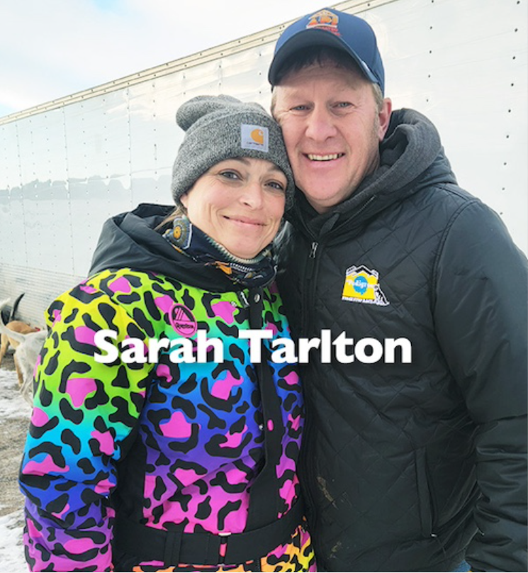
#6-Sarah Tarlton from Mountain, Wisconsin.
Age 45. Sarah started racing in 2019, only four years after she began handling dogs. She and her partner in crime, Ryan Beaber, his daughters, and their dogs live in northern Wisconsin. She’s completed the Cross Lake, CopperDog, The Pas, Tahquamenon Country and Northern Pines sled dog races, however the Stage Stop is one of her favorites. “It’s the kids! And getting to make a school presentation. The kids cheering us on is heartwarming and really gets my dogs pumped up to run!”

Slide 29
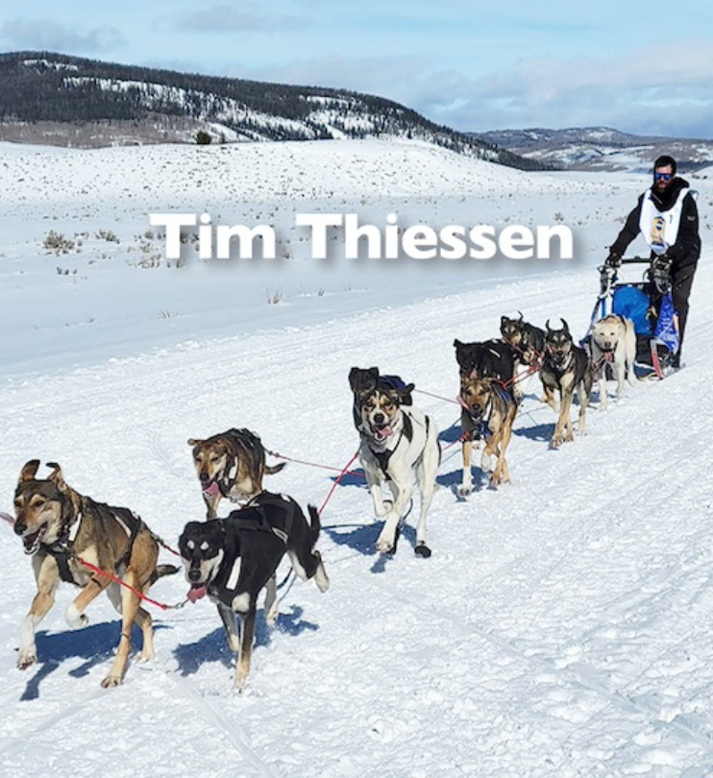
#7- Tim Thiessen from Leadville, Colorado.
Age 41. Tim has run the Stage Stop every year since 2019. His passion for dog sledding began in 2003 when he began working for a Breckenridge, Colorado sled dog tour company. He soon began competing in the local Colorado race circuit with his own team. Tim and his partner, Natalie, share their high-altitude homestead in Colorado with dogs, cats, ducks, chickens, and some geese. “Every year presents new challenges, and I’m excited to, once again, compete in this esteemed event!”

Slide 30
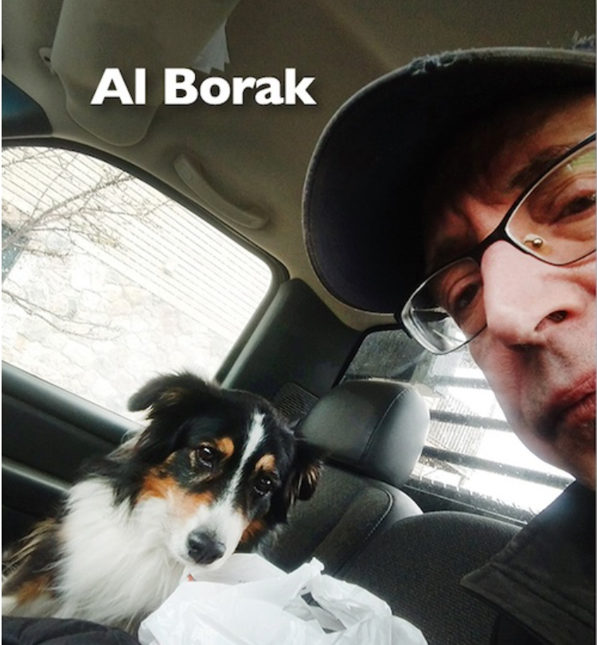
#8-Al Borak from Newberry, Michigan. Age 65.
Al is a detail guy who’s learned to read dogs, and how to take care of them. His special power is preparing young dogs to be world class racers which is exactly what he plans to do with a talented group of youngsters from Bruce and Laura Magnusson’s kennel. He says that at age 65 his list of hobbies is getting shorter and he’s spending more time planting trees on his family’s property and growing raspberries. “The Stage Stop is absolutely my favorite race.”

Slide 31
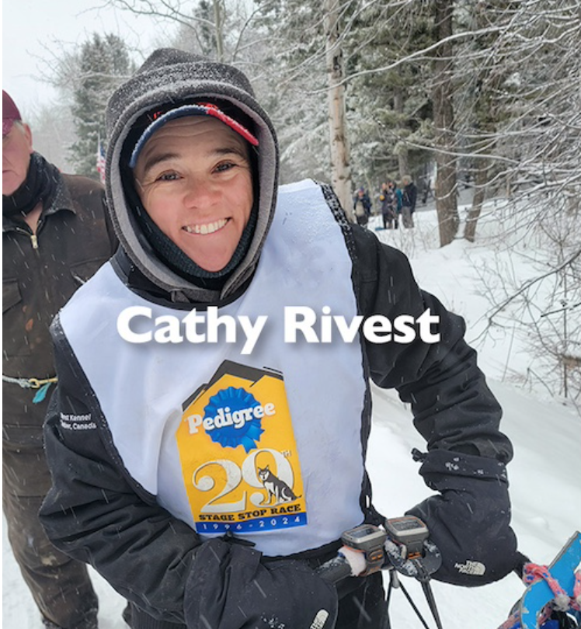
#9-Cathy Rivest from St-Paul-de-Joliette, Quebec, Canada. Age 49. “I began dogsledding around 12 years old, and we ran a tourist business with our sled dogs. That quickly became competition. One winter as a handler in Alaska, I saw famous races and mushers, and found my passion. I moved closer to town, my kennel shrank, and I began to race 4 and 6 dogs sprint class. My favorite race is Laconia, New Hampshire. I’m so thankful to race the Pedigree Stage Stop Race with my brother’s team. This stage race is a ‘must do’ of a lifetime.”

Slide 32
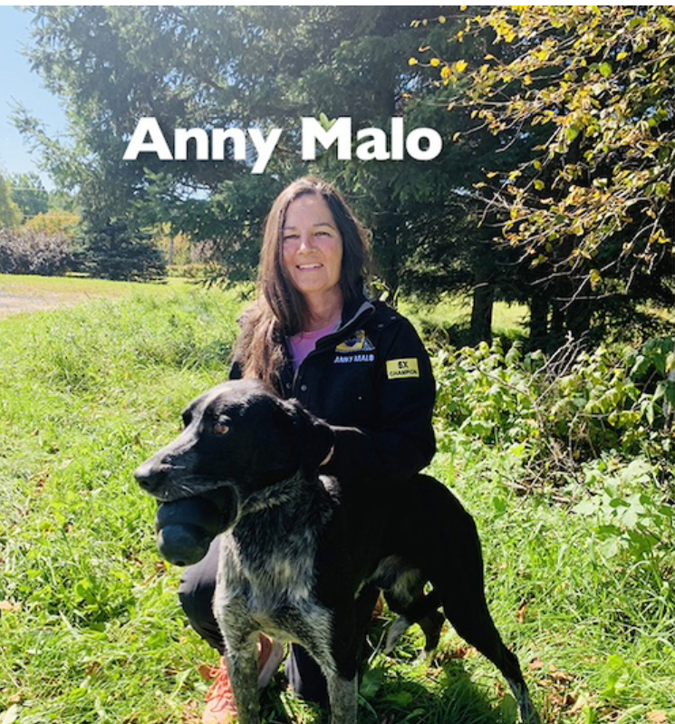
#10-Anny Malo from St-Zenon, Quebec, Canada. Age 54. “I started racing dogs in 1996 after I met my husband, Marco. In 1999 we got some precious teaching out of Joe and Pam Redington. From there, we raced western Canadian mid-distance events with mass starts and met so many good mushers. It became a family affair with our two boys following us on the road for at least a month every winter. I won the Pedigree Stage Stop as a rookie in 2019, then five Pedigree Stage Stop Races in a row. It is sure a format we love!!!!”

Slide 33
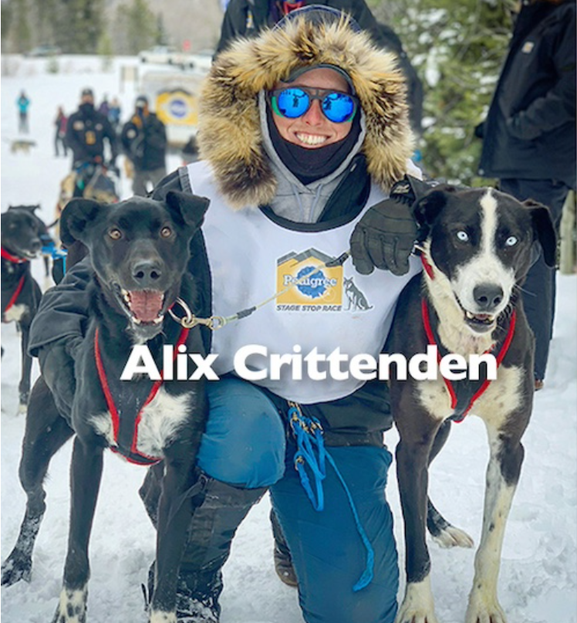
#11-Alix Crittenden, Bondurant Wyoming.
Age 37. Alix has been a professional musher for Jackson Hole Iditarod Sled Dog Kennel for many years. With her husband Sam’s support, she’s battled a brain tumor which was diagnosed about two weeks before last year’s race. Undaunted, every day she cheered her handler, Jess Moore, who finished third. Alix is excited to be back on the roster and wants to be on the top of that podium. “A battle with cancer makes everything physically harder but, somehow, at the same time makes it all feel easier mentally. I’m glad I’ve had dog mushing in my life to make me tougher and I’m ready for the race.”

Slide 34
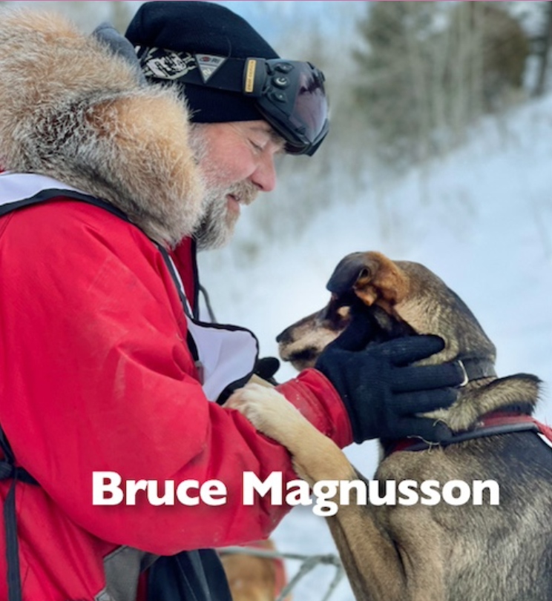
#12- Bruce Magnusson from Newberry, Michigan.
Age 61. Bruce has run the Stage Stop Race more times than any other competitor in our 30-year history. The first time he ever got on a sled was a race in 2002, where he placed second; his dad took first. Bruce was hooked! Now in his 22nd year of mushing, he lives and trains in Newberry, in the upper peninsula of Michigan where he has a kennel. “The Stage Stop is always the primary focus of our race season, and I can’t imagine not being a part of this race and the Stage Stop family.”

Slide 35
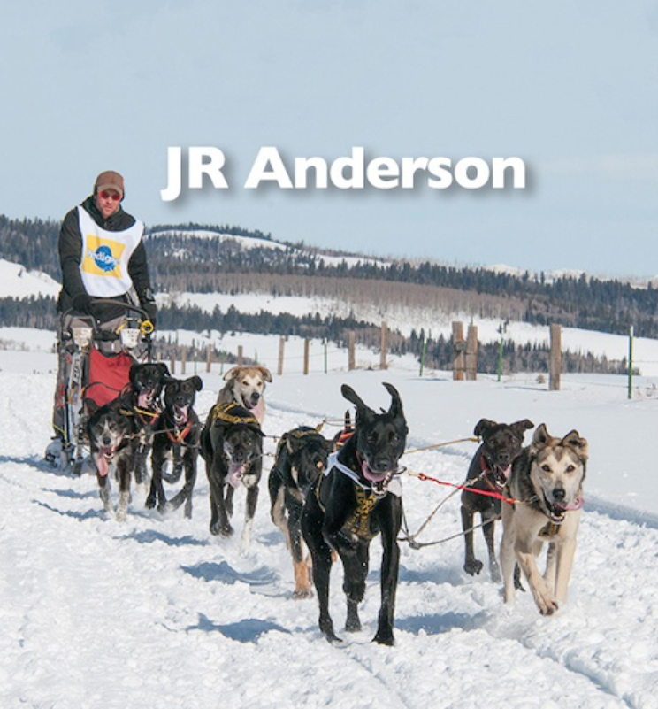
#13-JR Anderson from Buyck, Minnesota. Age 45. JR is a native of Minnesotan who has dedicated over 20 years to the sport of endurance canines. He and wife, Anna ‘Chapman’ Anderson, own the River Rock Kennel in Buyck, Minnesota. When not racing dogs, JR can be found playing with his daughter Sara and son Eli. Through research, extensive training, and competitive racing, he’s developed a keen knowledge of the canine’s ability to perform at accelerated levels.

Slide 36

#14- Leonie Tetzner, Burg Germany. Age 14 and 10 months at race time. “I race and train dogs, mostly open teams since I can stay on runners,” says Leonie, an enthusiastic, first time Stage Stop competitor. Leonie started running dogs when she was 4 years old. In Europe, she’s a bit of a media star, featured in radio, television and sports magazines. In 2023, she received the Susan’s Hope Award for Dog Care at the Fur Rondy. Leonie loves dogs — training, racing, and winning, and has 14 track record titles. “I like all the mushers and helpers from the Stage Stop!”

Slide 37
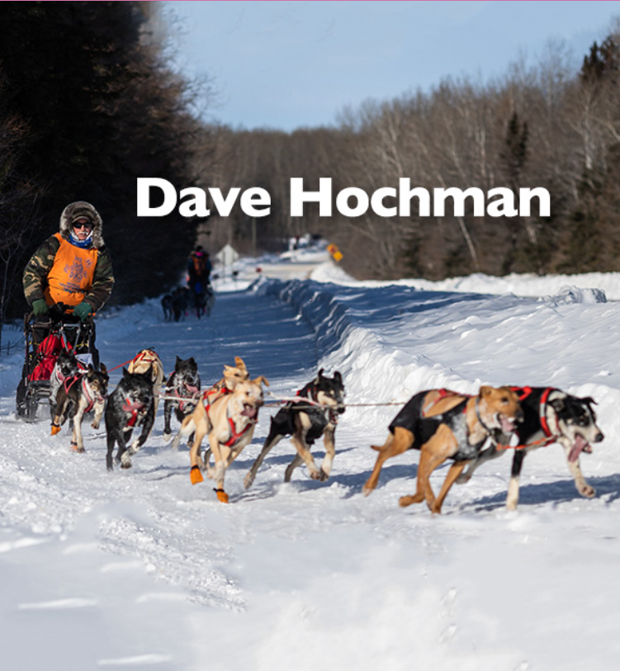
#15-Dave Hochman, Carlowrie, Manitoba, Canada. Age 59. Dave saw his first sled dog races at the Festival Du Voyager in Winnipeg, Manitoba in 1979. Afterwards, he convinced his mom to allow him three dogs, and that launched his mushing career. During the summer months, Dave is a provincial park maintenance worker. When not training sled dogs or working, he enjoys singing and playing in a band. Dave has two grown kids, Justin and Julie, and a wonderful partner, Janice, who is also his dog handler.

Slide 38
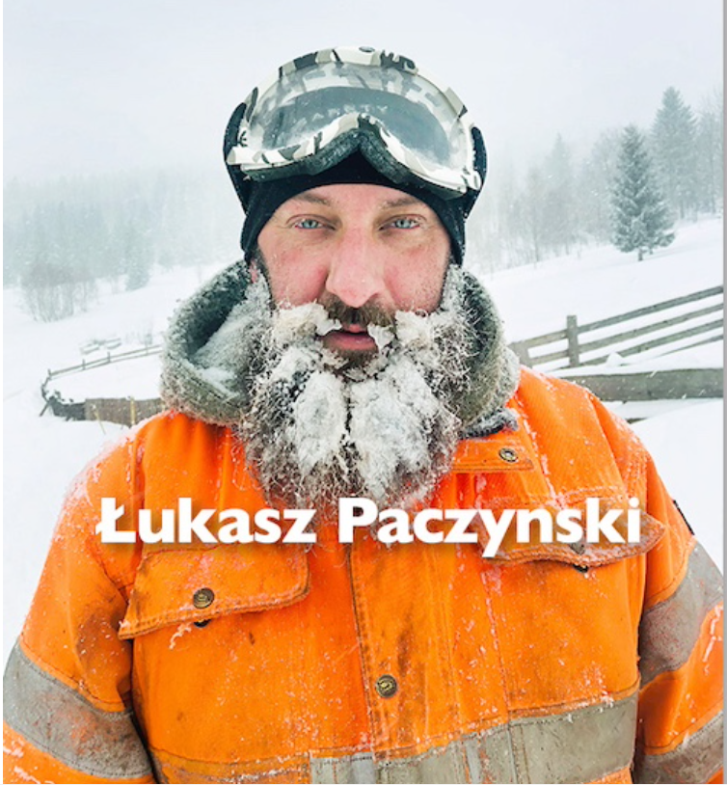
#16- Łukasz Paczynski — Swieradow-Zdroj, Poland. Age 45.
Łukasz began sprint racing in 2007 in the Siberian husky class, and took third place World Championship. Then he took on middle distance racing in Europe. Last year he competed in the Norway Trail race (International mid-distance), IFSS third place World Championship, and later the 2024 La Grande Odyssée where he took fifth place overall and was awarded Rookie of the Year. This is Łukasz’ first time running the Stage Stop so let’s give him a warm Wyoming welcome.

Slide 39
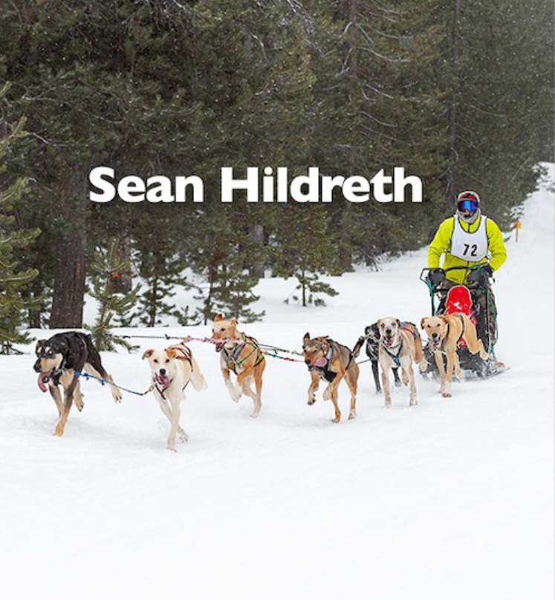
#17-Sean Hildreth, Bend, Oregon. Age 30. Sean began mushing in 2018 with Alpine Adventure Dog Sledding (Austin Forney’s kennel in Leadville, Colorado). “The first day of training I fell in love with the dogs, and the musher life,” he says. In 2022, Sean began working for Rachael and Jerry Scdoris at the Oregon Trail of Dreams where he worked with, and raced, their dog team. “Oregon and the kennel are my home, and the dogs are my family,” he says.

Slide 40

#18- Stéphane Roy from Sainte-Anne-de-Madawaska, New Brunswick, Canada. Age 34. Born and raised in Sainte-Anne-de-Madawaska, Stéphane started dog sledding at the age of five, and it became a daily activity. In the last three years he’s competed in the Can-Am Crown International Sled Dog Race, La Chic-Chocs 40 (first place, 2024), Defi Lotbiniere Nahak (second place, 2024), and Cross Lake Trappers Festival Race (fourth place, 2024). “I’ve dreamed of running the Pedigree Stage Stop Race for a long time and am glad I made it this year”.

Slide 41
Character Traits Information Chart
Character traits are descriptive adjectives that tell us more about a character.
They are like the words we would use to describe ourselves but we use them to describe characters in a book or text we are reading.
3. The character can be fictional or real.
4. We might infer a character trait by something the character does.
5. Character traits can be positive or negative.
Positive Traits Negative Traits
honest bossy
brave annoying
hard-working lazy

Slide 42
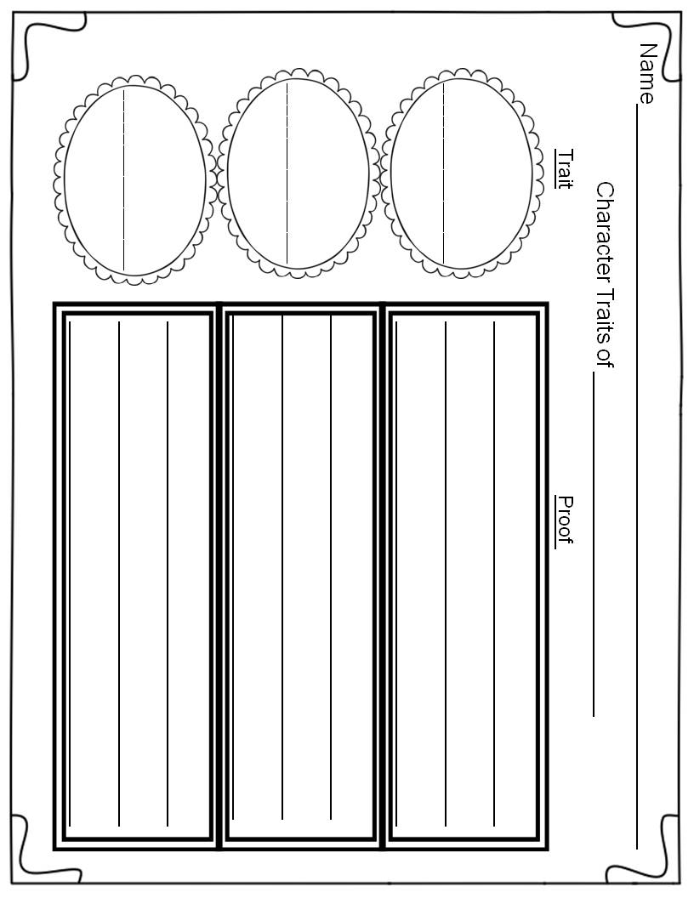

Slide 43

Adjectives
Adjectives are words that describe nouns:
a person, a place, a thing.
Adjectives answer the following questions:
how many?
which one?
what kind of?
Adjectives make our writing more interesting!

Slide 44

Name_________________________________________________
Write 6 adjectives that describe a sled dog racer.
Sled Dog Racer

Slide 45
Activities:
Here are some fun activities your students can do during
the Pedigree Stage Stop Sled Dog Race.
Pick a musher and keep a daily log of their location and
interesting information such as problems, weather conditions,
number of miles traveled, number of dogs, etc.
Map the sled dog race through Wyoming using the map. Students can map all the stage stops in Wyoming and label them.
Map the whole Pedigree Stage Stop Race on the Rocky
Mountains States Map and label the states and all the stage
stops.
Comparing Weather: Graph the high or low temperatures
each day for a city on the trail and the student’s
hometown.
Musher Log and Map
In this activity students will pick a musher to follow on the trail. Each day students will record the date, location, and important information about their musher. Important information might be about losing a dog, problems, weather conditions etc. You will need to make at least 2 copies of the log for each student or double side the log on one page. Then students will map out the trail each day and put cities and checkpoints if possible.
Materials:
Make copies of the Musher Log
Make copies of the Wyoming Map
Make copies of the Rocky Mountain Region Map
Compare Weather Chart

Slide 46
Name________________________________________________
Your Musher’s Log____________________________________
Day
Location
Important Information
__________________
__________________
__________________
__________________
__________________
__________________
__________________
__________________
__________________
__________________
__________________
__________________
__________________
__________________
__________________

Slide 47

Name_______________________________
Draw the trail through Wyoming and label each stage stop.

Slide 48
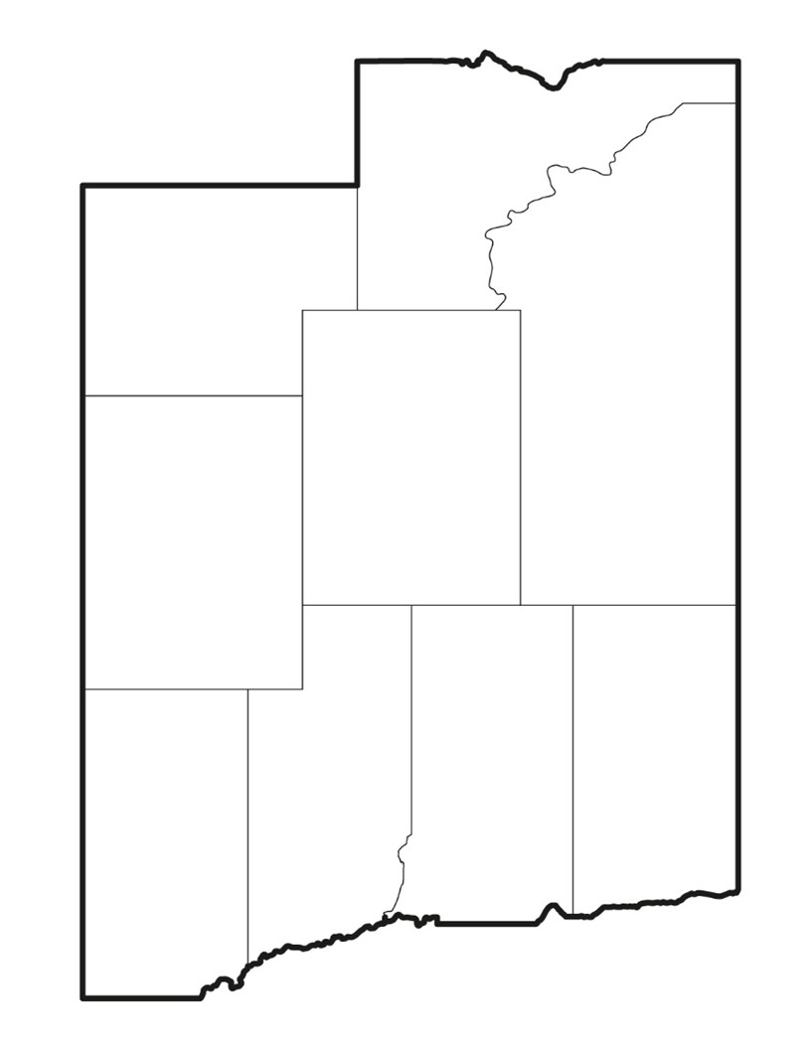
Name_______________________________
Draw the trail of the Pedigree Stage Stop Sled Dog Race and label each state.

Slide 49
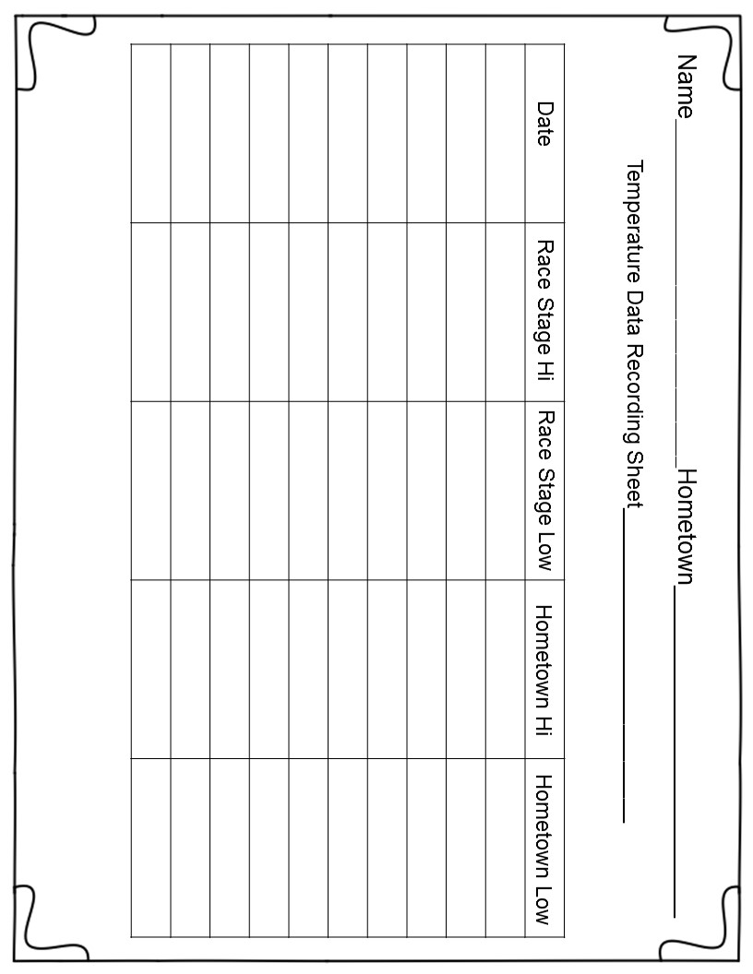

Slide 50
Activities:
Compare and Contrast 2 mushers.
Compare and Contrast the Pedigree Stage Stop Race to the
Iditarod. Students will need to do some research.
Wrapping it Up
Materials:
Make copies of the Venn Diagrams
Make copies of the Wrapping it Up Activity

Slide 51
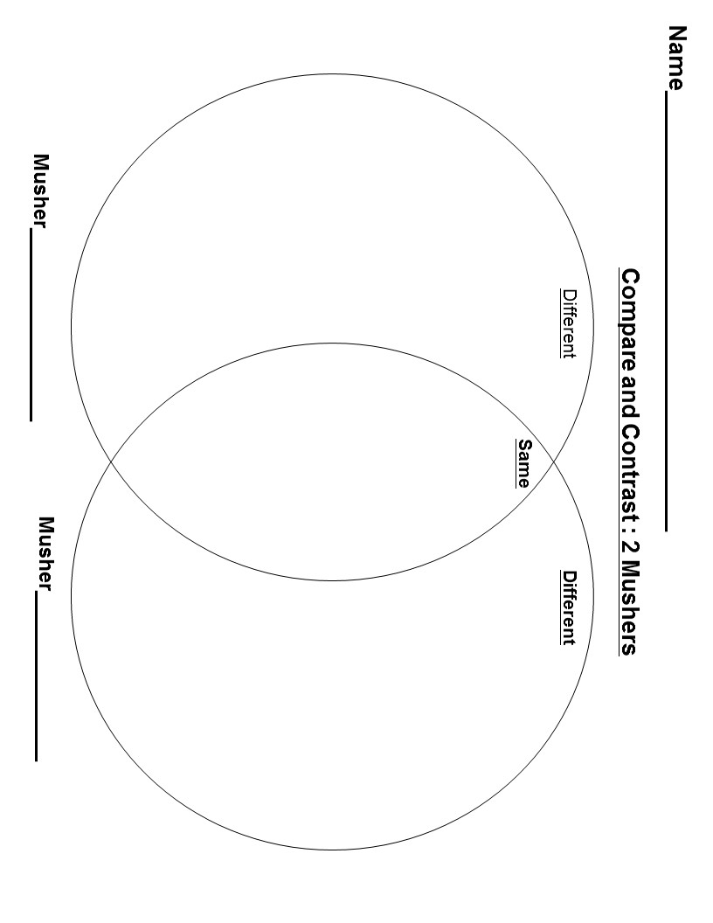

Slide 52
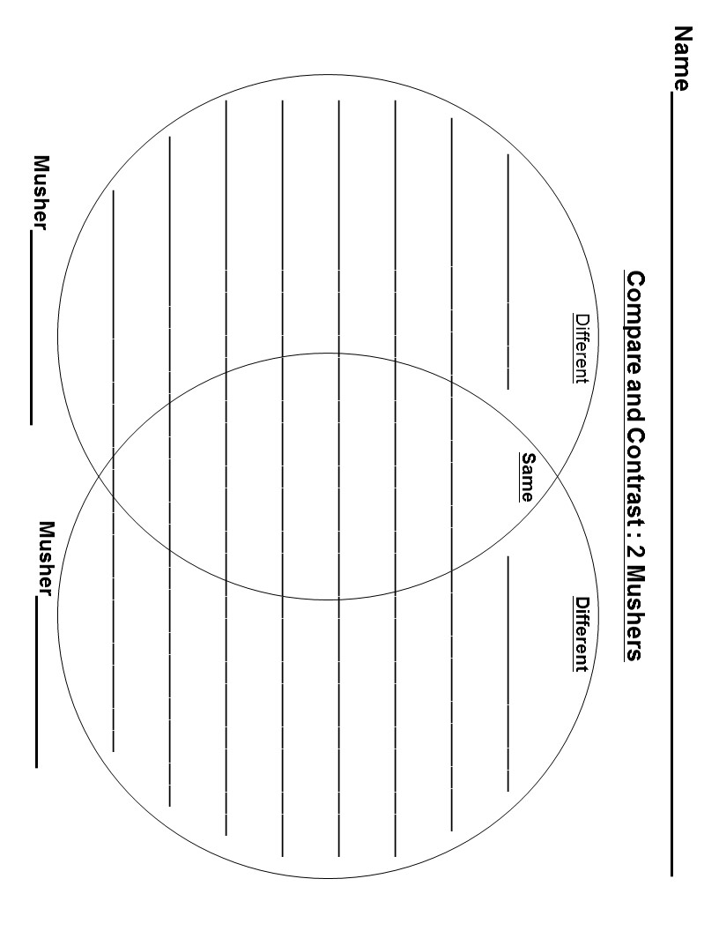

Slide 53
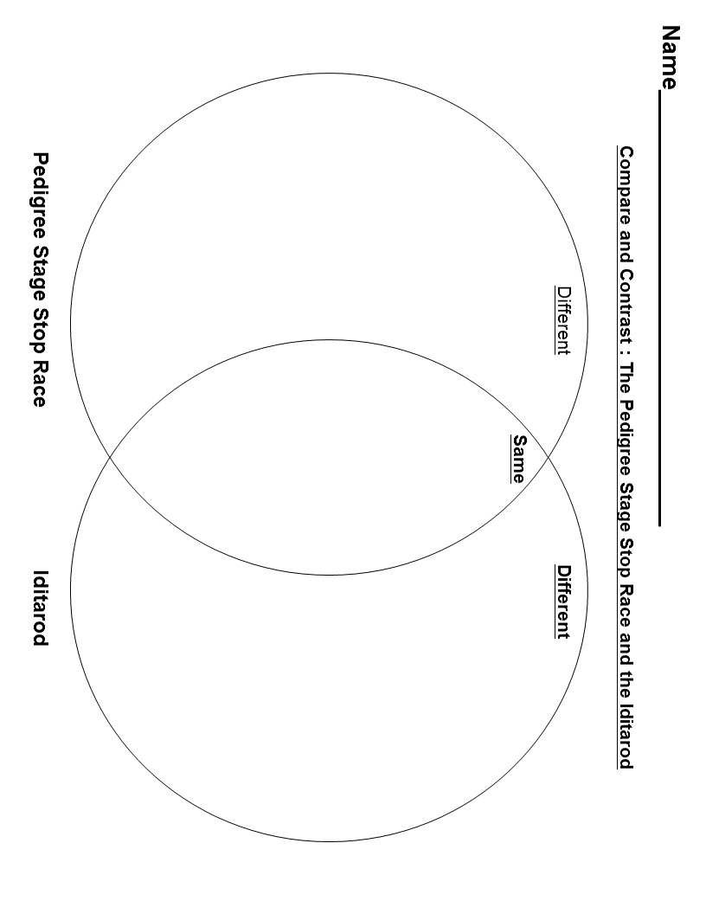

Slide 54
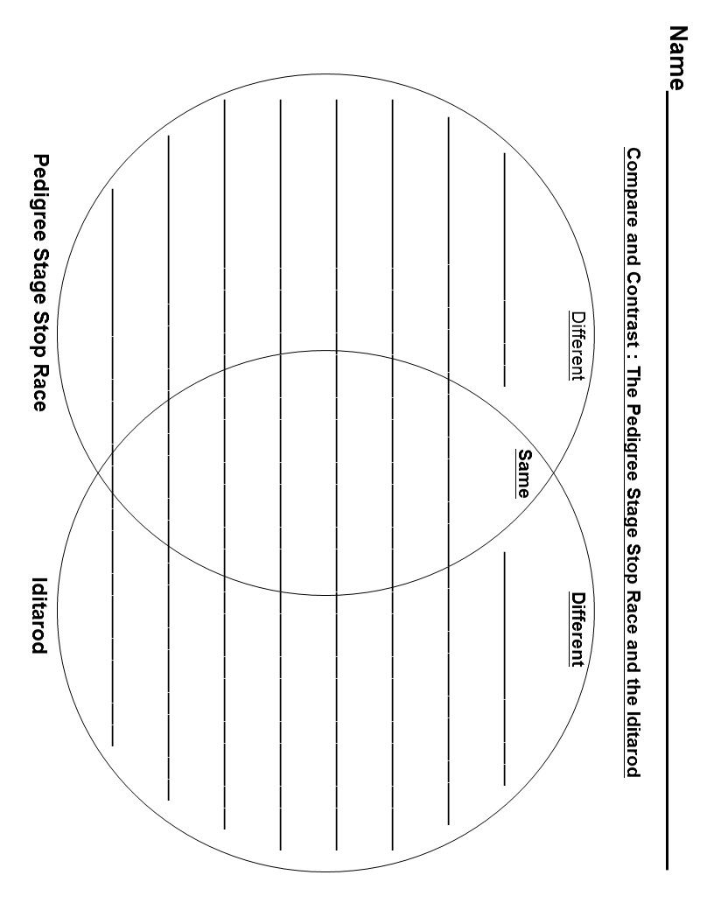

Slide 55

Name_____________________________________________
Wrapping it Up
Who won the Race?
_____________
_____________
_____________
What was the winning time?
_____________
_____________
_____________
How many mushers started
the race?
_____________
_____________
_____________
How many mushers finished the race?
_____________
_____________
_____________
copyright©2013ArleneSandberg

Slide 56

“Wyoming” Cinquain and Writing an “Stage Stop Sled Dog Race” Cinquain.
This is a wonderful website for learning about Cinquains and writing them.
http://www.poetry4kids.com/blog/lessons/how-to-write-a-cinquain-poem/
I have included the Cinquain writing form. After reading the Wyoming Cinquain, to your students hand it out. Go over the form of the Cinquain. Then brainstorm things about the Sled dog Race that students could write about.
Examples: racing, cold, lonely, dark, icy etc.
After writing them, students can share theirs with the class. This may be difficult for some younger students but you can try to do it as a whole group. These would make a great Bulletin Board Display. You can also make a class poetry book with the cover I have included.
Materials:
Make copies of the “Wyoming” Cinquain
Make a copy of the Cinquain writing form
Make copies of the Cinquain Writing Activity
Make a copy of the Class Poetry Book Cover

Slide 57




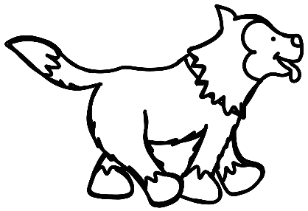
Name__________________________________________________
Wyoming
Cold, Windy, Snowy
Mushing, Fishing, Snowing
Land of the Rocky Mountains
Untamed
copyright©2013ArleneSandberg

Slide 58
Writing a Cinquain
Line 1 - a one word title (or 2 syllables)
Line 2- 2 words that describe your
title (or 4 syllables)
Line 3 - 3 words (verbs) that express
action (or 6 syllables)
Line 4- 4 words that express feeling
(or 8 syllables)
Line 5- One word that refers back to
the title. (or 2 syllables)

Slide 59

Name__________________________________________________
_____________________
___________________ __________________
______________ ______________ ______________
__________ __________ __________ __________
_______________________

Slide 60


Our Class Poetry
Book:
“Pedigree Stage Stop Race”

Slide 61
Writing Prompts
There are 4 writing prompts to chose from depending on the
writing abilities of your students. There is an Informative Text Information Chart and Writing Graphic Organizers and an Opinion Piece Writing Information Chart and Writing Graphic Organizers. You can choose the ones that meet the needs of your students.
Materials for both 2nd and 3rd Grade:
Make a copy of the Informative Text Information Chart
Make a copy of the Opinion Piece Information Chart
Materials:
2nd Grade Graphic Organizers:
Make copies of the Information Text Writing Graphic Organizer
Make copies of the Opinion Piece Writing Graphic Organizer
3rd Grade Graphic Organizers
Make copies of the Information Writing Graphic Organizer
Make copies of the Opinion Piece Writing Graphic Organizer
Writing Prompts:
Make copies of the writing prompts and laminate
Make copies of student writing papers (optional)

Slide 62
Informative/Explanatory
Text Writing
Begin with a topic sentence.
The topic sentence is the
main idea of the paragraph.
Add Facts and Details to tell
more about the main idea.
End your paragraph with a
concluding sentence which
restates the main idea.

Slide 63
Name__________________________________
Informative Text Writing Graphic Organizer
______________________
______________________
Topic
Sentence
______________________
______________________
Important
Fact
______________________
______________________
Important
Detail
Important
Fact or Detail
______________________
______________________
______________________
______________________
Concluding
Sentence

Slide 64
Name__________________________________
______________________
______________________
Topic
Sentence
______________________
______________________
Important
Fact
______________________
______________________
Important
Detail
Another
Important
Fact
______________________
______________________
Another
important
Detail
______________________
______________________
Concluding Sentence
______________________
______________________

Slide 65
Opinion Piece Writing
Begin by stating your opinion.
Examples: You can begin with
I believe, I think, I feel
Give reasons why you feel that way.
Give examples to support
your reasons.
Add a concluding sentence
which restates your opinion.

Slide 66
Name__________________________________
Opinion Piece Writing Graphic Organizer
______________________
______________________
State your
opinion.
______________________
______________________
Reason
______________________
______________________
Example
Another reason or example
______________________
______________________
______________________
______________________
Concluding Sentence

Slide 67
Name__________________________________
______________________
______________________
State your
Opinion.
______________________
______________________
Reason
______________________
______________________
Example
Another
Reason
______________________
______________________
______________________
______________________
Example
Concluding Sentence:
Restate your
opinion
______________________
______________________

Slide 68
Writing Prompt
Describe the Pedigree Stage Stop Race.
Give facts and details.
Check your spelling, punctuation, and capitalization.
copyright©2013ArleneSandberg
Writing Prompt
Imagine you are chosen to ride the first stage of the Pedigree Stage Stop Race. Describe the weather, crowd watching, and the trail ride.
copyright©2013ArleneSandberg

Slide 69
Writing Prompt
Imagine that you are a reporter interviewing a musher in the race.
What questions would you ask and why?
copyright©2013ArleneSandberg
Writing Prompt
Pick a town along the Wyoming Trail.
Find information about the town.
Write a paragraph describing the town.
copyright©2013ArleneSandberg

Slide 70

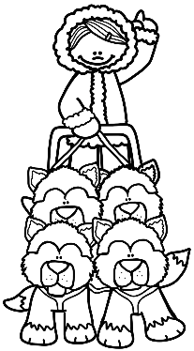


Name________
__________________________
______________________________________________________________________________________________________________________________________________________________________________________________________________________________________________________________________________________________________________

Slide 71


Name______________________________________________________
___________________________
______________________________
__________________________________________________________________________________________________________________________________________________________________________________________________________________________________________________________________________________________________________________________________________________________________

